Slide 1
NHLBI Approach to HeartShare Ancillary Studies
Division of Cardiovascular Sciences
Version 1, July 2023
Disclaimer: These are staff opinions and do not necessarily represent the official views of the NHLBI, NIH, nor DHHS.

Slide 2
Guide Notices and NOSIs for Funding Opportunities
Cite relevant Notices of Special Interest (NOSI) in application
PAR-21-038 Katz ESI R01 for innovative projects that are new research directions and no prelim data exist; expires 12/29/23
NOT-CA-22-037 “Validation of Digital Health and Artificial Intelligence Tools for Improved Assessment in Epidemiological, Clinical, and Intervention Research” to parent R01 PA-20-185 (Clinical Trial Not Allowed); expires 3/9/24
NOT-AG-21-045 “Opportunities for Research in Epidemiology of Alzheimer's Disease and Alzheimer's Disease-Related Dementias (AD/ADRD) and Cognitive Resilience” to parent R01 PA-20-185; expires 11/13/24
NOT-HL-21-030 “Heart, Lung, Blood and Sleep Focused Ancillary Studies to Large Ongoing Clinical Studies (Revised)” to parent R01 PA-20-185; expires 5/8/25
NOT-HL-23-067 “Integrative Omics Analysis of NHLBI TOPMed Data” to parent R01 PA-20-185; expires 5/8/26
NOT-HL-23-079 “Research Project Grants in Valvular Heart Disease (CAROL Act)” to parent R01 PA-20-185; expires 5/8/26
NOT-HL-23-066 “Development of Functional Assay Sites to Evaluate Candidate -Omics Variants Associated with Heart, Lung, Blood, or Sleep Disease” to parent R01 PA-20-185; expires 9/8/26
NOT-OD-21-011 “Smart Health and Biomedical Research in the Era of Artificial Intelligence and Advanced Data Science” to NSF 21-530; reissue underway; email NHLBI contact: Erin Iturriaga

Slide 3
Administrative Supplements
Consider applying for Administrative Supplements; email NHLBI contact
PA-21-071 “Research Supplements to Promote Diversity in Health-Related Research (Admin Supp – Clinical Trial Not Allowed)”; expires 6/30/23; reissue underway
NOT-AG-23-032 “Administrative Supplement Program to Help Develop Alzheimer’s-Focused NIH Grants” to PA-20-272; expires 10/3/23
NOT-HL-23-078 “Administrative Supplements to Encourage Research in Valvular Heart Disease (CAROL Act); expires 6/2/26

Slide 4
HeartShare Ancillary Pre-Submission Deadlines
Deadlines | New R01 applications requesting <$500K direct costs (DC) in any year
 | Cycle I: October Council | Cycle II: January Council | Cycle III: May Council
DTC Statistician, Core Lab, Biorepository Review* (10 weeks prior to R01 deadline) | November 27 | March 27 | July 27
Ancillary Study Proposal Receipt Date to PAS (8 weeks prior to R01 deadline) | December 11 | April 10 | August 10
PAS Review** (4 weeks prior to R01 deadline) | January 8 | May 8 | September 7
PI Contacts DTC for Letter of Support (2 weeks prior to R01 deadline) | January 22 | May 22 | September 21
R01 Application Receipt Date to NHLBI | February 5 | June 5 | October 5
* Required only if proposals include these components; if N/A, follow ancillary study proposal receipt date to PAS ** Approved proposals requiring major changes must be re-reviewed by PAS; if minor changes, revised proposals reviewed by PAS Chairs Abbreviations: DTC = Data Translation Center; PAS = Publication and Ancillary Studies Committee

Slide 5
HeartShare Ancillary & NHLBI 500K Process Pre-Submission Deadlines
Deadlines | New R01 applications requesting ≥$500K, <$1.515M DC in any year
 | Cycle I: October Council | Cycle II: January Council | Cycle III: May Council
DTC Statistician, Core Lab, Biorepository Review* (10 weeks prior to R01 deadline) | September 16 | January 14 | May 16
Ancillary Study Proposal Receipt Date to PAS (8 weeks prior to consultation) | September 30 | January 28 | May 30
PAS Review** (4 weeks prior to consultation) | October 28 | February 25 | June 27
PI Contacts DTC for Letter of Support (2 weeks prior to consultation) | November 11 | March 11 | July 11
NHLBI Staff Consultation Completed*** (earlier contact recommended) | November 25 | March 25 | July 25
NHLBI Letter of Request Deadline | December 14 | April 13 | August 14
NHLBI Decision to Accept Proposal (Letter of Acceptance Receipt) | December 28 – January 25 | April 27 – May 25 | August 28 – September 25
R01 Application Receipt Date to NHLBI | February 5 | June 5 | October 5
* Required only if proposals include these components; if N/A, follow ancillary study proposal receipt date to PAS ** Approved proposals requiring major changes must be re-reviewed by PAS; if minor changes, revised proposals reviewed by PAS Chairs *** Required consult is the first step to request NHLBI approval to submit an application ≥$500K, <$1.515M DC in any year
NHLBI 500K Process

Slide 6
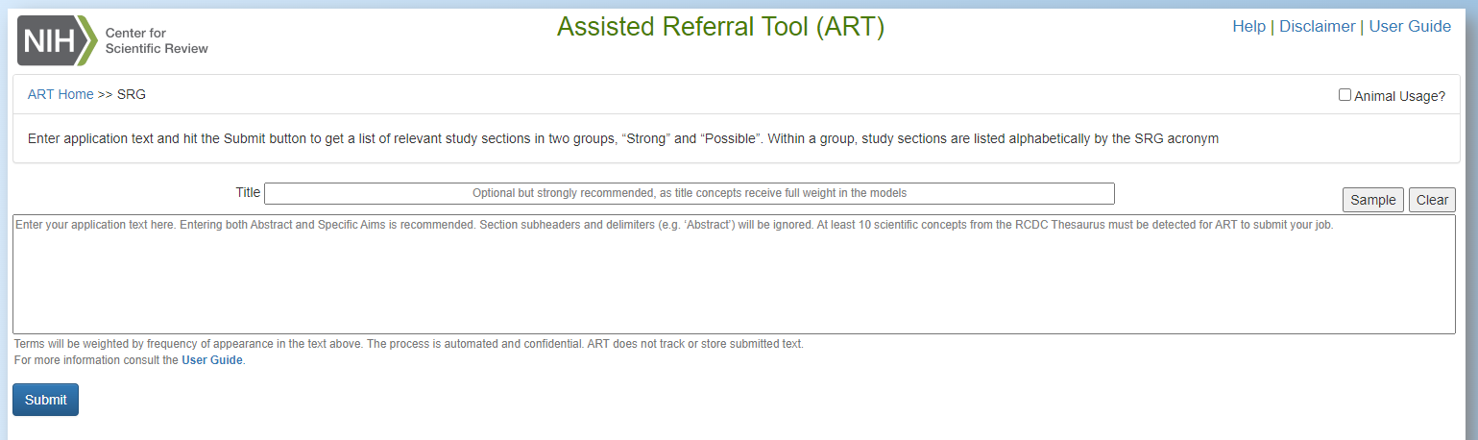
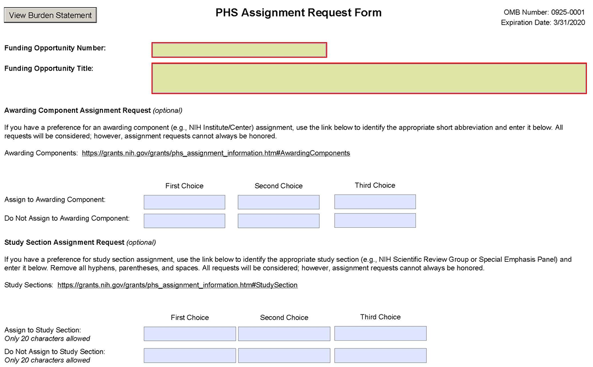
Need to Find a Program Official (PO), NIH Institute, or Study Section?
Enter an abstract or other scientific text into:
Matchmaker to find potential matching POs, Institutes, review panels, and similar funded projects
CSR’s Assisted Referral Tool (ART) to find recommended review panels
Review sample applications
Submit an Assignment Request Form (ARF) to help direct your application to a particular review panel
Suggestions will be considered by CSR, but not all can be honored
See guidance and instructions
6
Notes:
If you have an eRA Commons (link is external) account, you can use eRA's LikeThis (A Thesaurus-Based Search Tool) (link is external) to find funded projects and publications as well.

Slide 7
NHLBI Funding: Priorities?
PI-initiated Research Project Grants (RPGs)
Next Generation and Early Stage Investigators (ESIs)
10%tile advantage over R01 payline for ESI parent R01 applications and up to 5-year support for all years recommended by Council
5%tile advantage over R01 payline for 2nd R01 from ESI awardees and up to 5-year support for all years recommended by Council
ESI award is in last year or within 2 FYs after end date; not a PI on another R01*
Strategic Vision Aligned Opportunities
Grant Program | FY21 Paylines | FY22 Paylines | FY23 Paylines
R01 | 15%tile | 15%tile | 14%tile
ESI R01 | 25%tile | 25%tile | 24%tile
* See https://www.nhlbi.nih.gov/current-operating-guidelines for policy on 2nd R01 for ESIs (all criteria must be met)
Notes:
In this next slide here, I wanted to share some of the criteria in NHLBI funding priorities.
Investigator-initiated discovery science has been and will remain the bedrock of the NHLBI mission, and individual researchers will always be encouraged to pursue their ideas through investigator-initiated projects.
NHLBI has special considers for early stage investigators.
There are multiple factors that go into funding decisions: above all, scientific merit/score are most important, but other criteria are budget, portfolio balance, and alignment with the Strategic Vision.

Slide 8
Proposal Development Tips: Funding Strategies
Expanding expertise and capacity can be facilitated by applying to other NIH Institutes and Centers.
Non-federal support to leverage research dollars is encouraged.
Data science is increasingly important and offers improved capacity for the project, as well as the institution. Cost sharing should be considered.
Training grants may offer an alternate route to fund small studies, recruit new talent, and target workforce expansion.

Slide 9
Proposal Development Tips: Significance and Feasibility
How will the ancillary study add to HeartShare’s overall impact, scope, and innovation? How will study information be additive to HeartShare?
What additional information will be added to differentiate between HFpEF subtypes and provide potential insight to new therapeutic approaches?
What is the impact on patient recruitment and burden, as well as the overall program?
Are there ancillary study inclusion/exclusion criteria beyond that of HeartShare?
How will study efforts be coordinated across multiple sites?
How will site monitoring occur for overall data integrity?
Is there appropriate expertise and have other collaborators to been considered?
How feasible is the study timeline and approach to that of HeartShare’s (e.g., HeartShare dependency)?

Slide 10
Proposal Development Tips: Research Strategy
What are the preliminary data (e.g., previous examples, patient compliance, data quality and adequacy) and clear rationale to support premise and aims, as well as applicability/specificity to evaluating HFpEF patients (e.g., disease severity/progression vs. phenogrouping)?
What are the possibilities for longitudinal follow-up to link study with HFpEF pathophysiology?
What is the approach balance to hypothesis-driven vs. hypothesis-generating strategies?
Are there potential confounders that could affects study measures?
What are the sample size and statistical considerations? How adequate are they to address the hypothesis?
How will the ancillary study results be validated (e.g., leveraging non-HeartShare cohorts), contribute to a unique HFpEF phenotyping scheme (e.g., address diversity), inform future research, and potentially translate into clinical care?
What are alternative approaches and pitfall plans?

Slide 11
NHLBI and NIH Data Management and Sharing Policies
The final NIH Policy for Data Management and Sharing (DMS) took effect for apps submitted on/after January 25, 2023
The new NHLBI Supplement to the NIH DMS Policy became effective on May 25, 2023
Review policy site, trainings, FAQs, and example sample plans

Slide 12
Thank You!
Questions?
Vandana Sachdev, MD
HeartShare/HF AMP Project Lead
sachdevv@nhlbi.nih.gov
Patrice Desvigne-Nickens, MD
HeartShare Data Translation Center Program Official
desvignp@nhlbi.nih.gov
Emily Tinsley, PhD, MS
HeartShare Clinical Center Program Official
emily.tinsley@nih.gov
Renee Wong, PhD
Chief, Heart Failure and Arrhythmias Branch
wongr2@nhlbi.nih.gov

